Slide 1
Memory Management
Module CSN08101
Systems and Services
School of Computing Napier University

Slide 2
Learning Outcomes
➘ Understand the operation of paged virtual memories.
➘ Understand and critically appraise page replacement algorithms.
➘ Appreciate how memory is managed in modern Operating Systems

Slide 3
Paged Virtual Memory-1
➘ Two forms of paging:
➘ Demand paging - if the required page is not already in a memory frame
it will be swapped-in from disk.
➘ Anticipatory paging - attempts to predict in advance that a page will be
needed and ensures it is swapped-in ahead of any reference to it.
➘ When the running process tries to access a page which is not loaded into
a frame the process blocks. (i.e. moves from running to blocked state).
➘ The page table for a process has an ‘invalid’ bit.
➘ This means that the page is not currently loaded in a memory frame.
➘ A ‘page-fault’ interrupt occurs to signal that another page is needed.
➘ The memory manager locates the required page in the swap file.
➘ If a frame is free the page is loaded and the page table updated
➘ If no frame is free, a page-turning algorithm will decide which page
must be swapped-out to make a frame available.

Slide 4
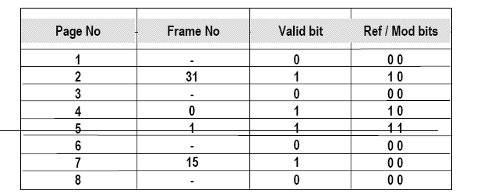
Paged Virtual Memory-2
➘ For example: a process occupies 8 pages of which 5 are currently in memory.
➘ The Page Table below shows this state
➘ Pages 2, 4, 5, and 7 are in memory, and are loaded in the frames 31, 0, 1,
and 15 respectively. The ‘valid’ bit is set to show this.
➘ Pages 0, 2, 3 and 6 are not currently in memory and this is shown by the
‘valid’ bit = 0.
➘ The “referenced” bit shows if the contents of a frame have been
accessed since the page was loaded. In this case pages 2, 4 and 5
have, but page 7 has not.
➘ The “modified” bit shows if the contents of a frame have been
changed since the page was loaded. In this case only Page 5 has
changed.

Slide 5
Page replacement algorithms -1
➘ The objective is to avoid replacing a page which will be need to be reloaded
soon, because it is referenced again.
➘ This results in the extreme case in “page thrashing”:
➘ two pages refer to each other, one is loaded, refers to the second, and is
replaced to make room for second, which then references first page etc.
➘ Most algorithms attempt to predict future use from evidence of past use.
➘ Algorithms can be tested against a “reference string”
➘ This is a pre-defined list of memory addresses
➘ When stepping through the set of addresses each algorithm will generate
a number of page faults.
➘ The lower the number number of page faults caused, the better the algorithm
- for that reference string.
➘ The validity of the results depends on how realistic the reference string is.
➘ If a page has changed since it was loaded, the “M” (modified) bit will be
set, and the page must be written back to disk before reusing the frame.

Slide 6
Page replacement algorithms -2
➘ Two status bits commonly used:
➘ R bit - page has been referenced (any form of access).
➘ M bit - page has been modified (only set for written).
➘ The possible combinations are:
➘ 00 - (class 0) not referenced or modified
➘ 01 - (class 1) not referenced, modified (!)
➘ 10 - (class 2) referenced, not modified
➘ 11 - (class 3) referenced and modified
➘ Note (!) Class 1 can occur where R bit is cleared periodically (every
OS clock timer interrupt) to distinguish recently referenced pages
from those referenced some time ago
➘ The page table also include other fields, or bits, such as timestamp(s) for
last access(es)
➘ These have been omitted for clarity

Slide 7
Page replacement algorithms -3
➘ First-In/First-Out (FIFO).
➘ A simple approach in which the “oldest” page is removed.
➘ “Oldest” means the page that was loaded earliest.
➘ Either the Page Table shows the time the page was loaded (swapped-in)
or a time-ordered queue of pages is held separately.
➘ May give poor performance if oldest page is also heavily used
➘ For example, a page holding status information or program code which
is loaded early in the job and is used frequently thereafter.
➘ There is an interesting phenomenon called “Belady’s Anomaly”
➘ A job running in a given size of memory causes a number of page
faults. An increase in the size of the memory may cause an
increase in the number of page faults.
➘ A further increase significantly reduces the number of page faults.
➘ This is an example of a “local maximum” on an otherwise
decreasing curve.

Slide 8
Page replacement algorithms -4
➘ Least Recently Used (LRU).
➘ Decides which page to replaces by looking at the most recent time of access,
not the time the page was loaded.
➘ This is an attempt to use the recent past to predict the future.
➘ There needs to be a record of when each page is accessed. This is costly:
➘ Either the Page Table has an entry to record the time of last access or a
separate linked list of page numbers is maintained.
➘ As each page is referenced the list is manipulated to put most recent
page at the front, so the oldest used goes to the rear of the list.
➘ Optimal
➘ Easy to describe, but impossible to implement.
➘ When a page fault occurs, label each page with the number of instructions
before that page will be referenced.
➘ The page with the highest count will be replaced.
➘ Process specific, and unachievable, but useful for evaluating other algorithms.

Slide 9
Page replacement algorithms -5
➘ Least Frequently Used (LFU)
➘ Based on the observed behaviour that pages heavily used by recent
instructions will be heavily used again soon.
➘ Needs an additional counter of references to each page,and some form of
linked list with higher counts near the front and lower counts at the rear.
➘ The page with the lowest reference count (i.e. at the back) is replaced.
➘ Problems include:
➘ Some pages are heavily used at initialisation and then are no longer
needed.
➘ These pages may have a high enough reference count to be
retained.
➘ This may unfairly remove recently loaded pages which will be
needed soon.
➘ Solution is an ageing mechanism
➘ For example, a “hit rate” obtained from references divided by time
loaded.

Slide 10
Page replacement algorithms -6
➘ Second Chance
➘ A modified form of FIFO which tries to prevent heavily used pages being
unloaded simply because they were loaded early.
➘ Uses R and M bits, plus a list of pages ordered by time of loading.
➘ Each page in the list is inspected in turn, oldest first.
➘ If the R bit is 1 (page recently referenced), move the page to the \
head of the list as if it had just been loaded.
➘ Change access time to current time.
➘ Clear the R bit to zero (not referenced).
➘ If the R bit is zero the page is unused recently (no recent references)
➘ Unload the page to free its frame.
➘ If M bit set page must be written to disk.
➘ Thus, in each period of time, an older page that has been referenced will
be given a “second chance”.
➘ Pages not referenced in the current clock period are unloaded.

Slide 11
Other issues in paged memory management -1
➘ Other techniques -
➘ Most-frequently used:
➘ Replace the most frequently used page - it probably won’t be used
again.
➘ Multiple category algorithms:
➘ Distinguish the four classes as earlier, using R/M bits:
➘ untouched - neither read nor written
➘ unread but written
➘ read but unwritten
➘ read and written, then:
➘ Each class processed separately in order.
➘ Separate the creation of free frames, from the demand for a page change:
➘ Increase the point at which page replacement is invoked from “all frames
in use” to “only n empty frames left”
➘ This retains a pool of spare frames to speed changeover.
➘ Frame clearing can be done when processor would otherwise be idle.

Slide 12
Other issues in paged memory management -2
➘ Other techniques (continued) -
➘ Use idle time to copy used pages out to disk.
➘ A form of “garbage collection daemon” where a very low priority
process tidies up memory instead of running the system idle process.
➘ When a page is chosen for replacement, mark the page free (by resetting
the “valid” bit), but retain the frame number in page table.
➘ If the original page is wanted again, before the frame is reloaded with
new content, simply mark page as valid.
➘ used in VAX/VMS OS
➘ Circular list implementation of second Chance algorithm (The “Clock”
algorithm)
➘ Random replacement algorithm.
➘ Somewhat cynical view that the choice will probably be wrong so a
random one is as good as any, and faster.

Slide 13
Other issues in paged memory management -3
➘ Pre-paging
➘ Pure demand paging causes many page faults at start-up and after each
swap-out.
➘ Balance time to load set of pages with time to process page faults, and so
identify the set of active pages for a process and load all together.
➘ A “Working Set” model
➘ This is a minimum no. of frames required by a process:
➘ System dependent, but conceptually 3 are needed (with indirect
addressing).
➘ Page(s) with current instruction, current operand(s) and current value(s).
➘ In Windows NT, the working set is in the range 20 - 345
➘ Thrashing
➘ Occurs when the number of frames allocated to a process is less than the
number of active pages.
➘ Process causes a page fault whose resolution causes another and so on
➘ More time spent paging than executing.

Slide 14
Converting page address to frame address -1
➘ Translation lookaside buffer (TLB).
➘ The page table for a process can be large,and “slow” to access
➘ Logical address space 2GB and 4KB page implies up to 524,288 pages)
➘ Recently used pages tend to be used again soon.
➘ The TLB is a hardware cache of recently used page table entries.
➘ Sequence of operations is:
look at TLB
if TLB hit (i.e. entry is in TLB)
then access memory using frame number from TLB entry
else if TLB miss
then look at Page Table
if Page Table hit (i.e. entry is in page table)
then access memory using frame number from page table
else cause a page fault to load page from disk)
endif
endif
endif

Slide 15
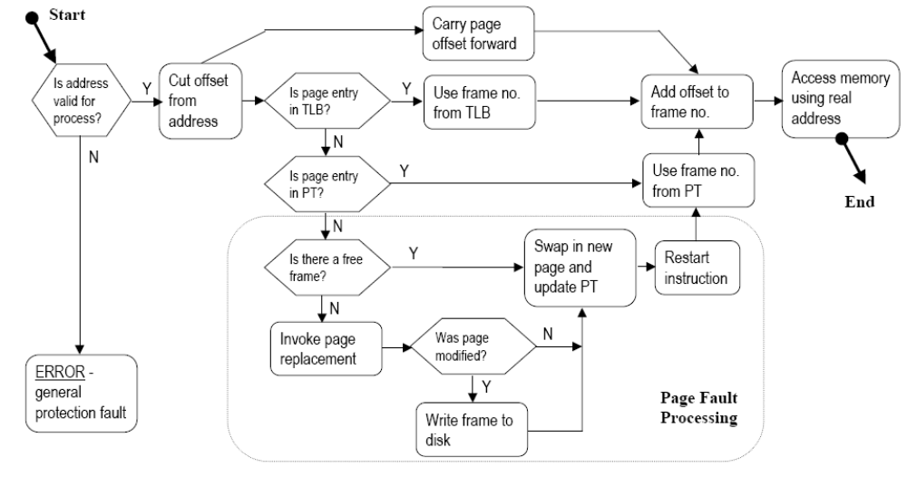
Converting page address to frame address -2

Slide 16
Segmentation -1
➘ An alternative form of VM, providing more control to the programmer than
paging.
➘ In paging there is a single logical address space for the process
➘ Addresses start at 0 and rise to some limit (232 –1 in Windows NT/XP).
➘ Different areas of the process can only grow within that address space
➘ Text, Data, Stack, Process Control Block each allocated a separate area.
➘ One component may fill its area, while another has free space
➘ In a segmented memory, there can be several address spaces for each
process, each with its hardware register support
➘ Each area of the process has own segment
➘ Addresses in each segment start at 0 and rise to some (high) limit
➘ Segments can grow or shrink independently
➘ The four areas of a process could be a separate segment, and each could
expand without colliding with another area.
➘ Segmentation can be implemented in a paged virtual memory, with each
segment implemented over one or more virtual pages. .Here, segments are loaded as a series of pages so it ia a paged-segmented scheme.

